Slide 1
C.A.S.T.L.E
Capacity-Aligned Stable Teaching Location Engine
Matthieu MINGUET
04/11/2024

Slide 2
I
II
III
Current Problem and Market Opportunities
Preferences and utility
Under the engine
IV
V
Results and simulation
modularity

Slide 3
C.A.S.T.L.E
I
Current Problem Market Opportunities

Slide 4

Current Room Allocation System at X
Tedious & Time consuming : Google Sheets by hand, multiple actors
Arbitrary : Registrars office allocates the room
Single-criteria : Room Occupancy and fit
An ineffective system that doesn’t allow stakeholders to participate
and doesn’t take into account pedagogical needs

Slide 5

Room Allocation System at Clermont SB
Tedious : Done manually by a full-time employee
Difficult: Program directors request room and time slots
Slow: 2-3 month in advance : precise cohort size unknown
Unclear: Central one person clearinghouse, no transparency
A difficult and unclear process but allowing professor input

Slide 6
Global Market Impact and Existing systems
Globally : Universities ~18500 worldwide, ~250m students
Target: Top universities in developed markets : 80 Unis, 2m students
Clearhouses if any are manual : X, CSB, INSEAD, HEC
No papers or advertising of such a system
A broad reach and potential for CASTLE

Slide 7
C.A.S.T.L.E
II
Preferences and Utility

Slide 8
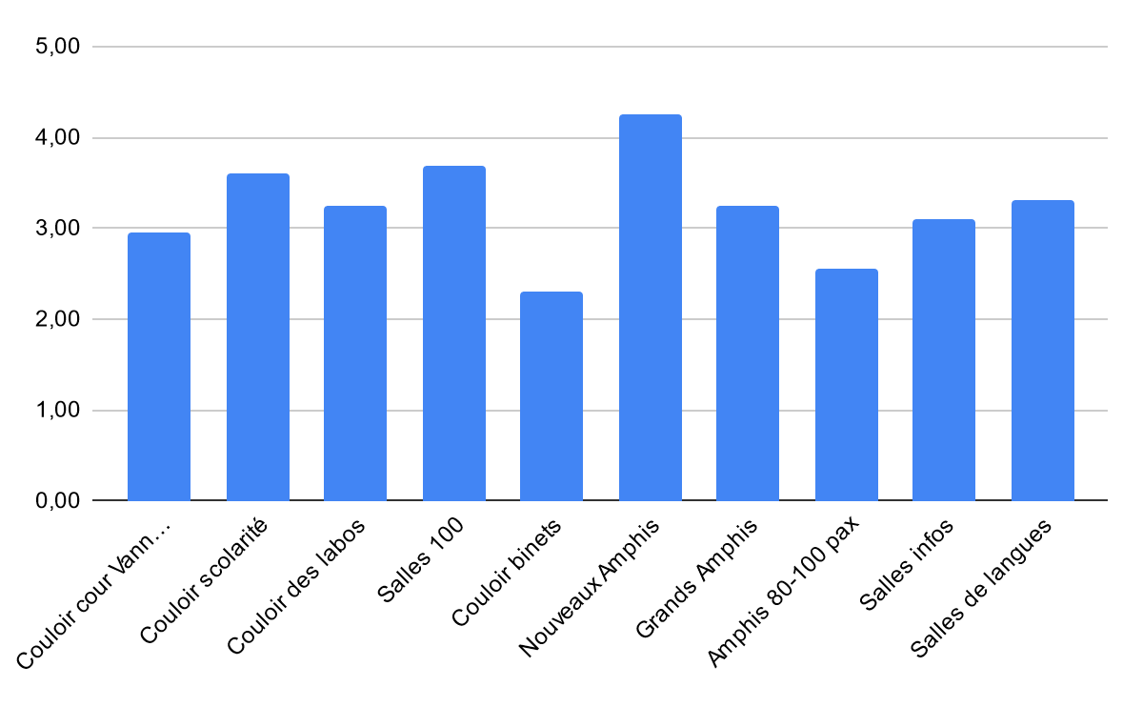
Differences in Room Appreciation
Polling of students
Organized by type
Differences are important, but not detrimental
Relative diversity of answers
Ranking of the room types
Differences in room appreciation warranting optimization

Slide 9
Drivers of differenciation
Room Equipment: screen, boards, sockets, tables…
Room size: lectures vs tutorials,
Room Disposition: flat, inclined, isles
proximity to essential: Magnan, coffee, labs
A variety of factors that affect learning and quality of life

Slide 10
Why use CASTLE ?
Professor Side
Administration Side
Profs have a say in the classroom allocation
Prioritize and signal their room preferences
Improve learning and QoL
Ease the load on the Registrar’s office
Efficient allocation of the school’s ressources
Allow quick changes
Considers Professors’ preferences…while being easier to plan out

Slide 11
C.A.S.T.L.E
III
Under the hood

Slide 12
Inputs and core principles
CASTLE
Room Data
Capacity
Type
Course Data
Professor preference
Cohort size
Deferred Acceptance
One to Many
A proven one to many matching system

Slide 13
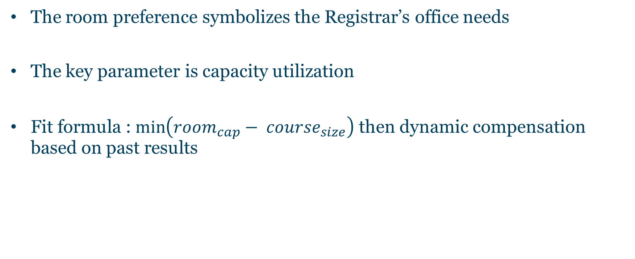
Calculating the Rooms’ preferences
The room preference symbolizes the Registrar’s office needs
The key parameter is capacity utilization
Fit formula : $\min\left({room}_{cap}− {course}_{size}\right)$ then dynamic compensation based on past results

Slide 14
Detailed Algorithm Pipeline
Course Propose to current top room type
Pool of courses per room type, including occupants
Iterate over rooms, choose best fit
Tentatively allocate the room to the chosen course
Remaining courses propose to next type
Continue until all courses are placed or no remaining choices
An efficient and automated process in Java

Slide 15
C.A.S.T.L.E
IV
Results and Simulation

Slide 16
C.A.S.T.L.E
V
Modularity

